Slide 1
Mathematical Preliminaries – I
(Linear Algebra)
Lecture 2
Part 1
Generative AI for Computer Vision

Slide 2
Content
  Vectors
    Definitions
    Basic Operations on Vectors
  Matrices
    Representations and Basic Operations
    Matrix Transpose and Inverse
  Eigenvalues and Eigenvectors
    Definition
    Geometrical Interpretation

Slide 3
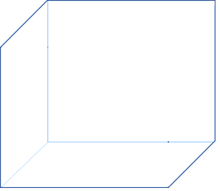
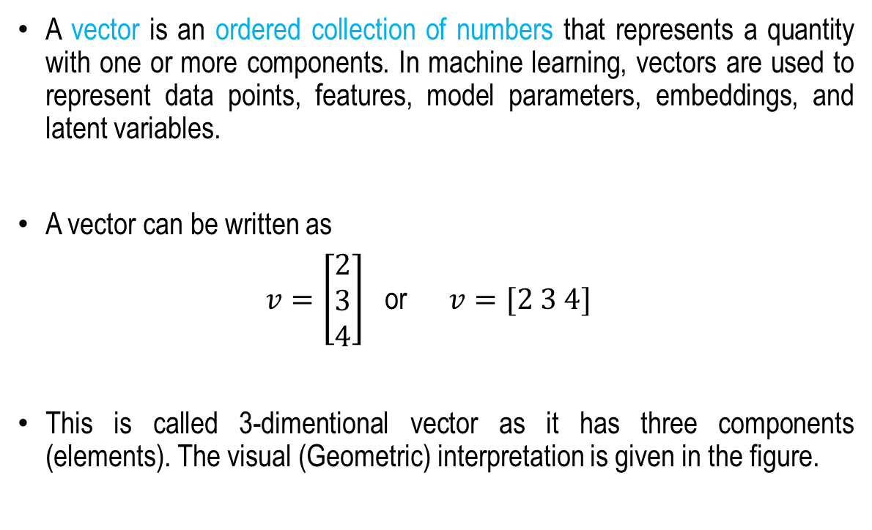
Vectors
A vector is an ordered collection of numbers that represents a quantity with one or more components. In machine learning, vectors are used to represent data points, features, model parameters, embeddings, and latent variables.
A vector can be written as
$v=\left[\begin{matrix}2 \\ 3 \\ 4\end{matrix}\right]$ or $v=[2 3 4]$
This is called 3-dimentional vector as it has three components (elements). The visual (Geometric) interpretation is given in the figure.
z
4
V(2,3,4)
3
y
2
x

Slide 4
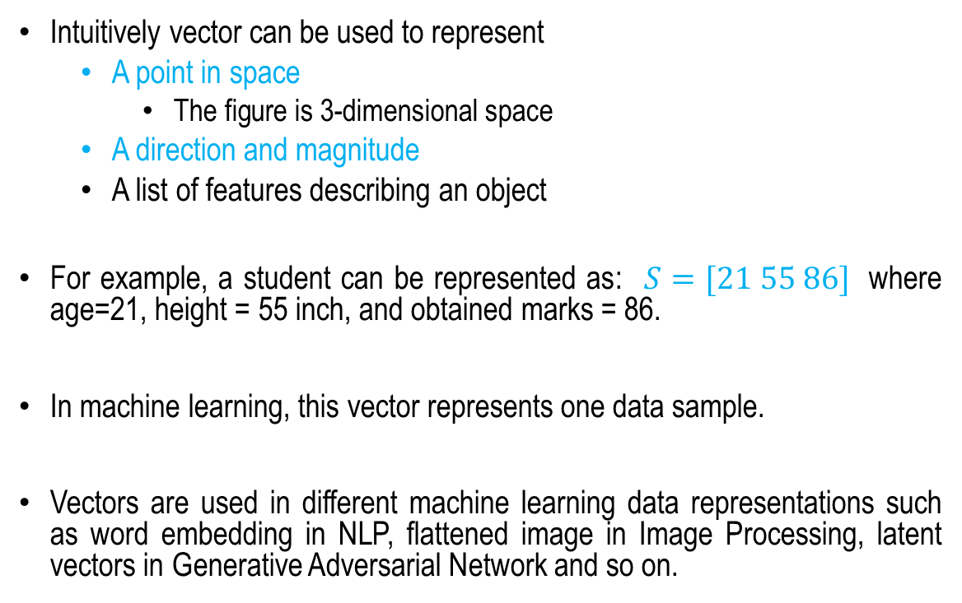
Use of vectors
Intuitively vector can be used to represent
  A point in space
    The figure is 3-dimensional space
  A direction and magnitude
  A list of features describing an object
For example, a student can be represented as: $S=[21 55 86]$ where age=21, height = 55 inch, and obtained marks = 86.
In machine learning, this vector represents one data sample.
Vectors are used in different machine learning data representations such as word embedding in NLP, flattened image in Image Processing, latent vectors in Generative Adversarial Network and so on.
z
4
V(2,3,4)
3
y
2
x

Slide 5
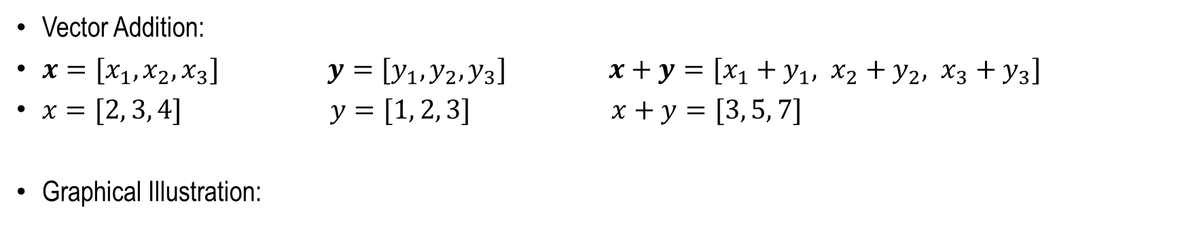
Basic Operations on Vectors
Vector Addition:
$x=[x_{1}, x_{2}, x_{3}]$ $y=[y_{1}, y_{2}, y_{3}]$ $x+y=[x_{1}+y_{1}, x_{2}+y_{2}, x_{3}+y_{3}]$
$x=[2, 3, 4]$ $y=[1, 2, 3]$ $x+y=[3, 5, 7]$
Graphical Illustration:
x
x
z
z
y
y
y
x
Vector Addition z=x+y using
triangular (Head-to-Tail) method
Vector Addition z=x+y using
parallelogram method

Slide 6


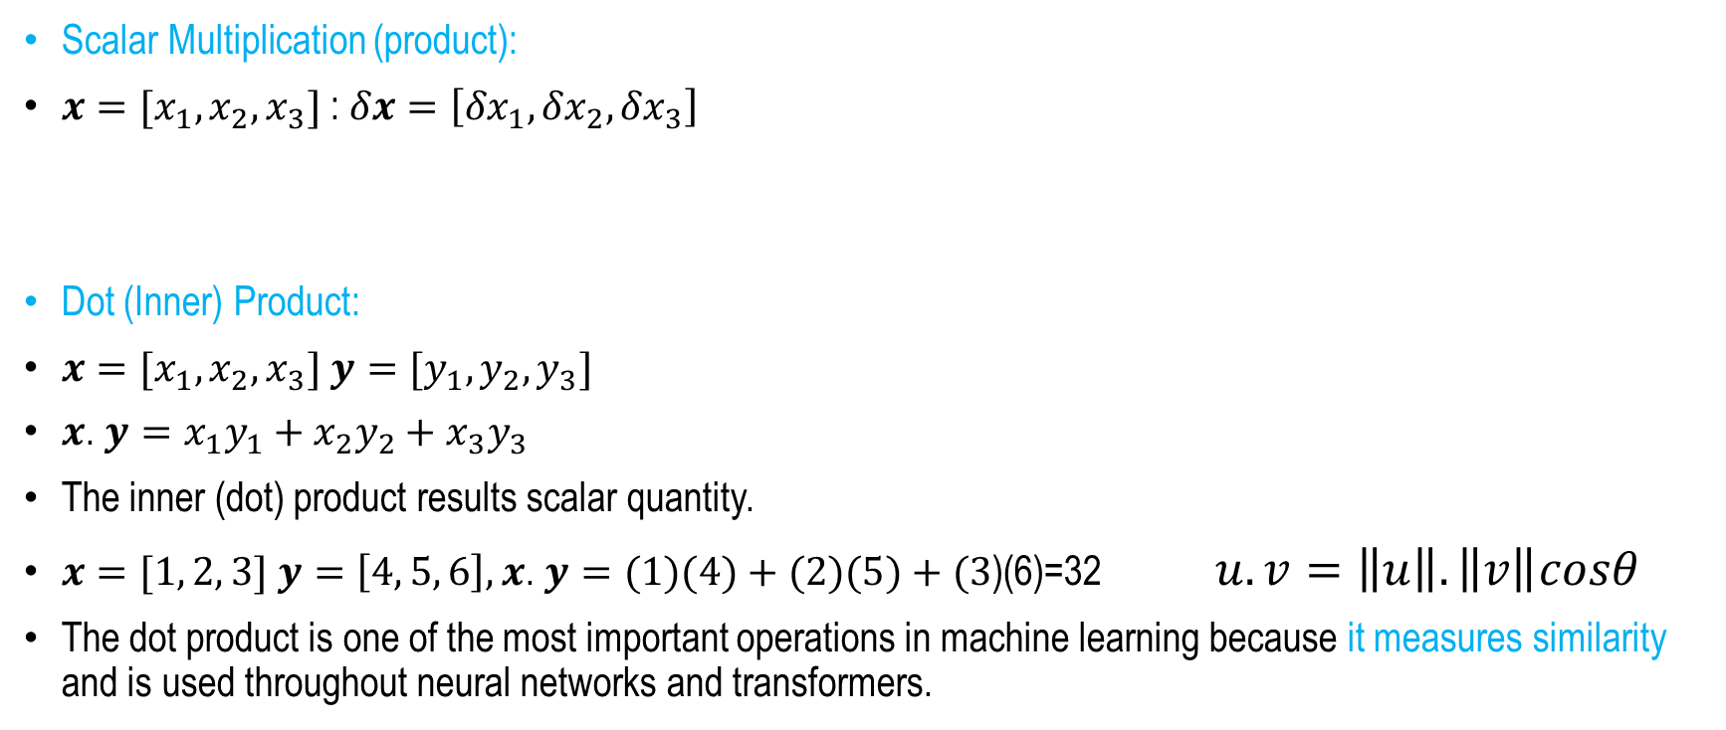



Basic Operations on Vectors
Scalar Multiplication (product):
$x=[x_{1}, x_{2}, x_{3}]$ : $δx=\left[{δx}_{1}, {δx}_{2}, {δx}_{3}\right]$
Dot (Inner) Product:
$x=[x_{1}, x_{2}, x_{3}]$ $y=[y_{1}, y_{2}, y_{3}]$
$x$. $y=x_{1}y_{1}+x_{2}y_{2}+x_{3}y_{3}$
The inner (dot) product results scalar quantity.
$x=[1, 2, 3]$ $y=\left[4, 5, 6\right], x$. $y=(1)(4)+(2)(5)+(3$)(6)=32 $u.v=\left\|u\right\|.\left\|v\right\|cosθ$
The dot product is one of the most important operations in machine learning because it measures similarity and is used throughout neural networks and transformers.
$$δx$$
$$x$$
$$u$$
$$θ$$
$$v$$

Slide 7
Matrices
Matrix représentation
Matrix Basic Operations (Addition, Substruction and Multiplication)
Matrix transpose
Identity matrix
Matrix Inversion

Slide 8
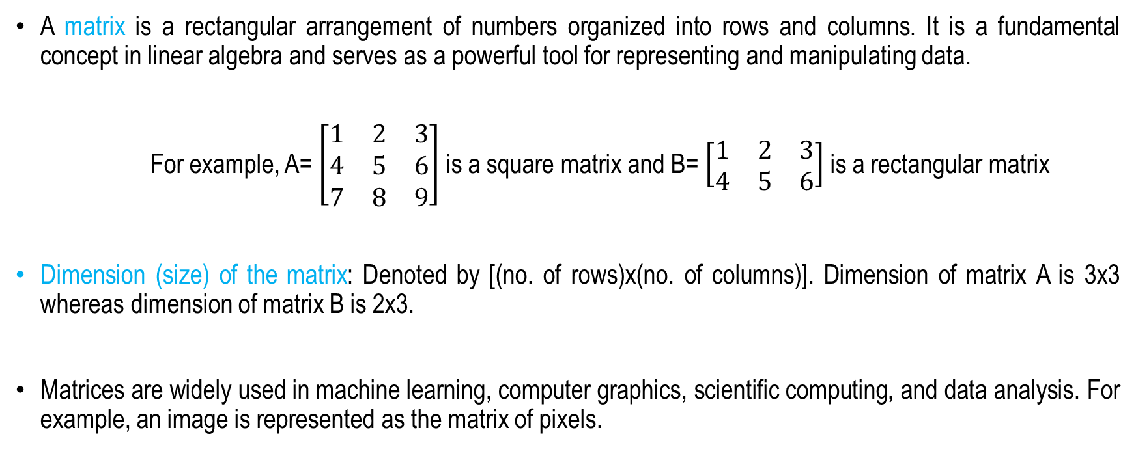
Matrix
A matrix is a rectangular arrangement of numbers organized into rows and columns. It is a fundamental concept in linear algebra and serves as a powerful tool for representing and manipulating data.
For example, A= $\left[\begin{matrix}1 & 2 & 3 \\ 4 & 5 & 6 \\ 7 & 8 & 9\end{matrix}\right]$ is a square matrix and B= $\left[\begin{matrix}1 & 2 & 3 \\ 4 & 5 & 6\end{matrix}\right]$ is a rectangular matrix
Dimension (size) of the matrix: Denoted by [(no. of rows)x(no. of columns)]. Dimension of matrix A is 3x3 whereas dimension of matrix B is 2x3.
Matrices are widely used in machine learning, computer graphics, scientific computing, and data analysis. For example, an image is represented as the matrix of pixels.

Slide 9
Matrix
Basic Operations
Matrix Addition: Just element-wise addition. Dimensions of the two matrices must be same.
Matrix Subtraction: Element-wise subtraction. Dimensions of the two matrices must be same.
Matrix Multiplication: Multiply each row with each column. Column dimension of the first matrix should be same as row dimension of the second matrix. If A is of dimension [3x4] and B is [4x5], Product matrix (A.B) will be [3x5]

Slide 10
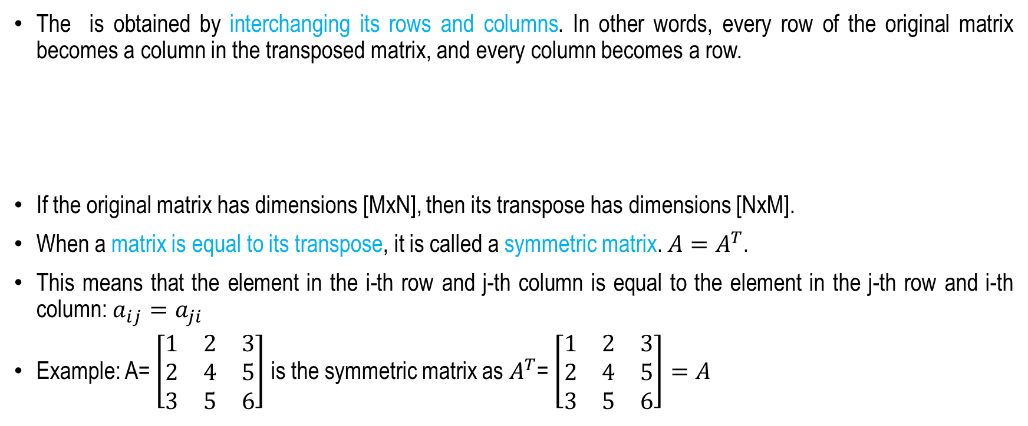
Transpose of a Matrix
The is obtained by interchanging its rows and columns. In other words, every row of the original matrix becomes a column in the transposed matrix, and every column becomes a row.
If the original matrix has dimensions [MxN], then its transpose has dimensions [NxM].
When a matrix is equal to its transpose, it is called a symmetric matrix. $A=A^{T}$.
This means that the element in the i-th row and j-th column is equal to the element in the j-th row and i-th column: $a_{ij}=a_{ji}$
Example: A= $\left[\begin{matrix}1 & 2 & 3 \\ 2 & 4 & 5 \\ 3 & 5 & 6\end{matrix}\right]$ is the symmetric matrix as $A^{T}$= $\left[\begin{matrix}1 & 2 & 3 \\ 2 & 4 & 5 \\ 3 & 5 & 6\end{matrix}\right]=A$

Slide 11
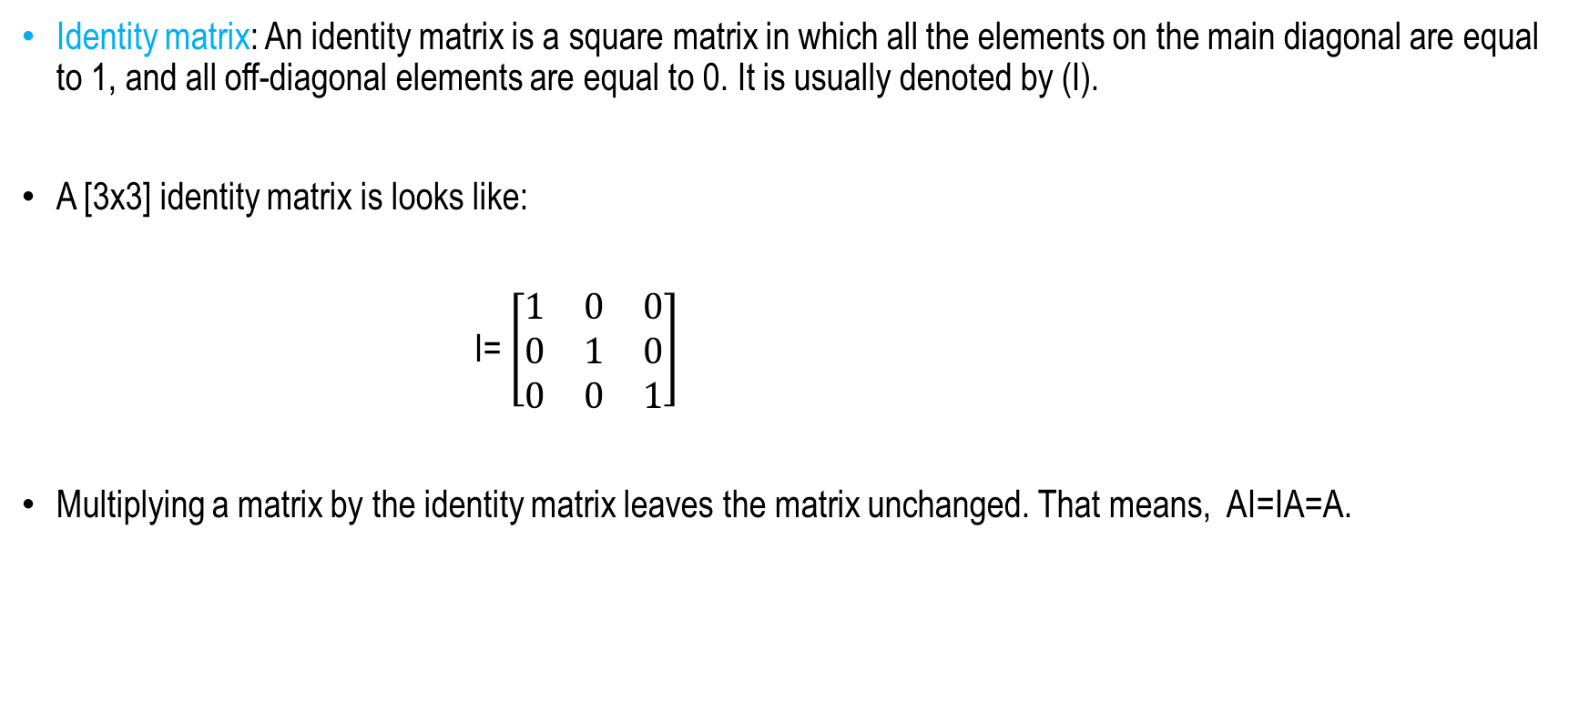
Identity Matrix
Identity matrix: An identity matrix is a square matrix in which all the elements on the main diagonal are equal to 1, and all off-diagonal elements are equal to 0. It is usually denoted by (I).
A [3x3] identity matrix is looks like:
I= $\left[\begin{matrix}1 & 0 & 0 \\ 0 & 1 & 0 \\ 0 & 0 & 1\end{matrix}\right]$
Multiplying a matrix by the identity matrix leaves the matrix unchanged. That means, AI=IA=A.

Slide 12
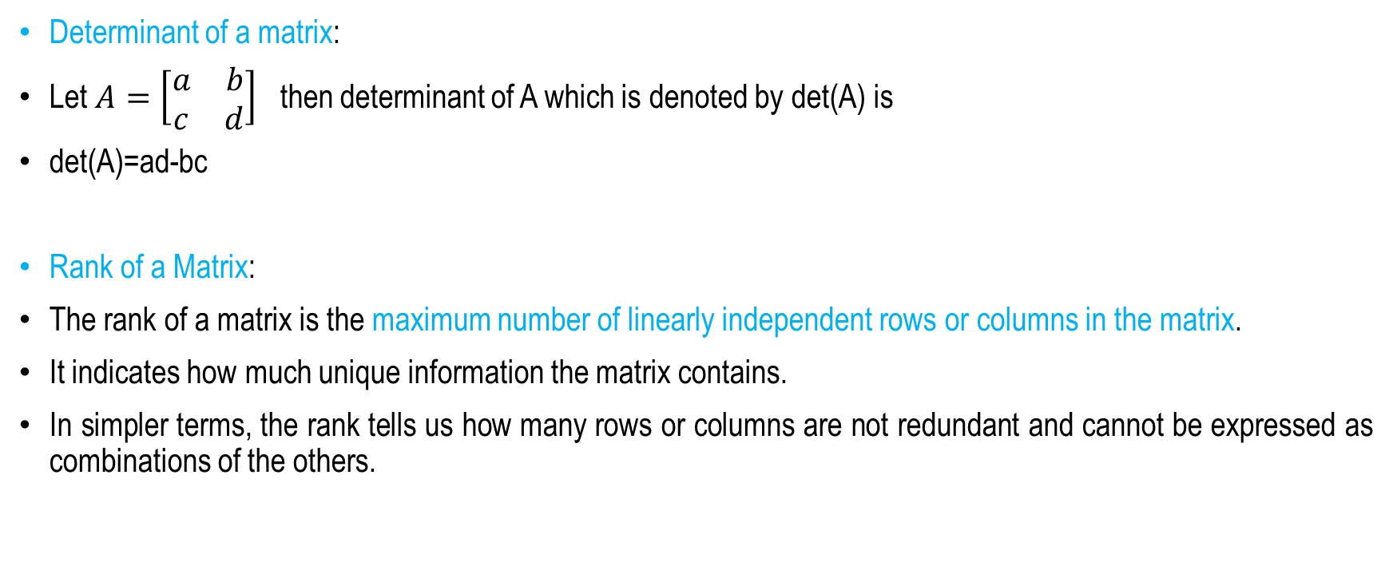
Matrix: A Few Definitions
Determinant of a matrix:
Let $A=\left[\begin{matrix}a & b \\ c & d\end{matrix}\right]$ then determinant of A which is denoted by det(A) is
det(A)=ad-bc
Rank of a Matrix:
The rank of a matrix is the maximum number of linearly independent rows or columns in the matrix.
It indicates how much unique information the matrix contains.
In simpler terms, the rank tells us how many rows or columns are not redundant and cannot be expressed as combinations of the others.

Slide 13
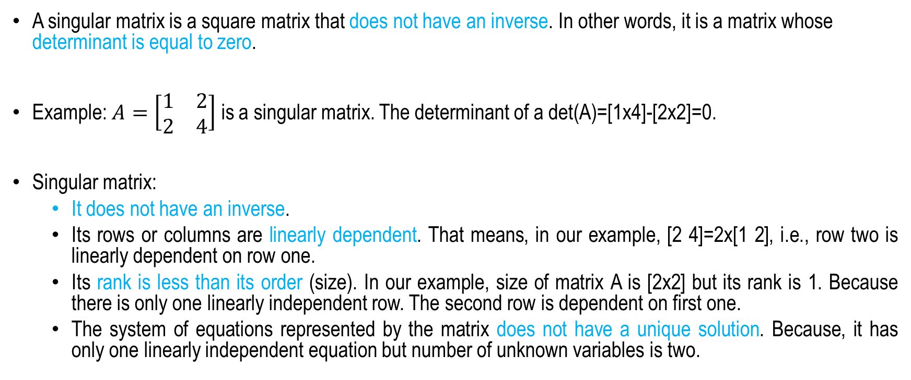
Singular Matrix
A singular matrix is a square matrix that does not have an inverse. In other words, it is a matrix whose determinant is equal to zero.
Example: $A=\left[\begin{matrix}1 & 2 \\ 2 & 4\end{matrix}\right]$ is a singular matrix. The determinant of a det(A)=[1x4]-[2x2]=0.
Singular matrix:
  It does not have an inverse.
  Its rows or columns are linearly dependent. That means, in our example, [2 4]=2x[1 2], i.e., row two is linearly dependent on row one.
  Its rank is less than its order (size). In our example, size of matrix A is [2x2] but its rank is 1. Because there is only one linearly independent row. The second row is dependent on first one.
  The system of equations represented by the matrix does not have a unique solution. Because, it has only one linearly independent equation but number of unknown variables is two.

Slide 14
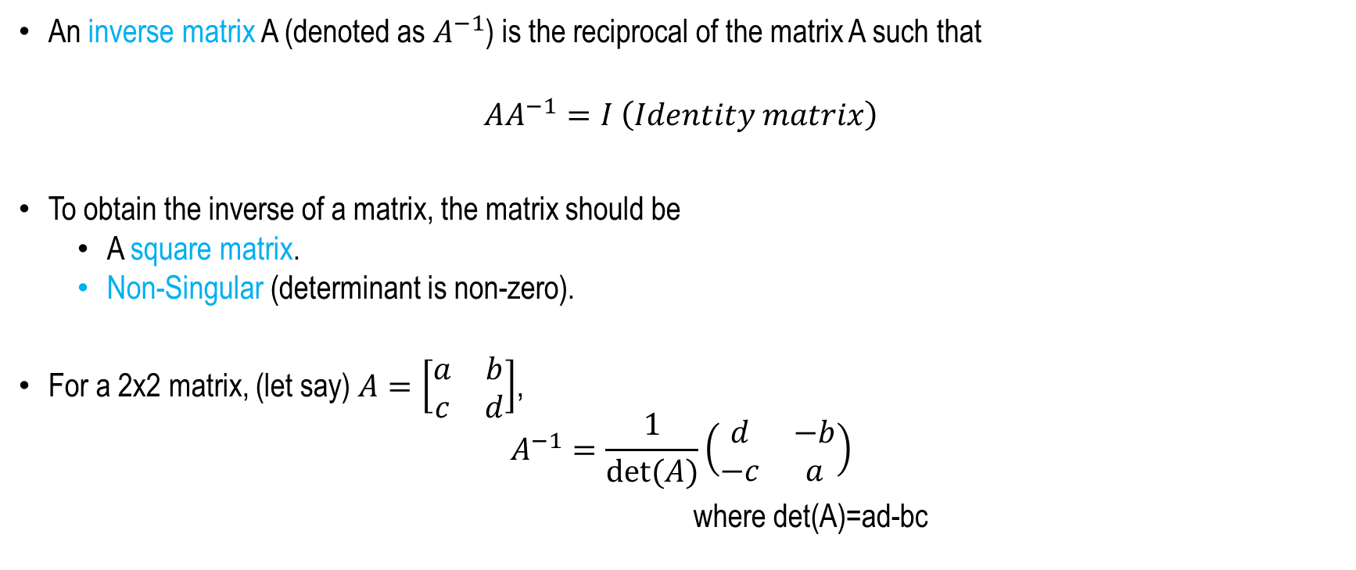
Matrix Inversion
An inverse matrix A (denoted as $A^{−1}$) is the reciprocal of the matrix A such that
$${AA}^{−1}=I \left(Identity matrix\right)$$
To obtain the inverse of a matrix, the matrix should be
  A square matrix.
  Non-Singular (determinant is non-zero).
For a 2x2 matrix, (let say) $A=\left[\begin{matrix}a & b \\ c & d\end{matrix}\right]$,
$$A^{−1}=\frac{1}{det⁡(A)}\left(\begin{matrix}d & −b \\ −c & a\end{matrix}\right)$$
where det(A)=ad-bc

Slide 15
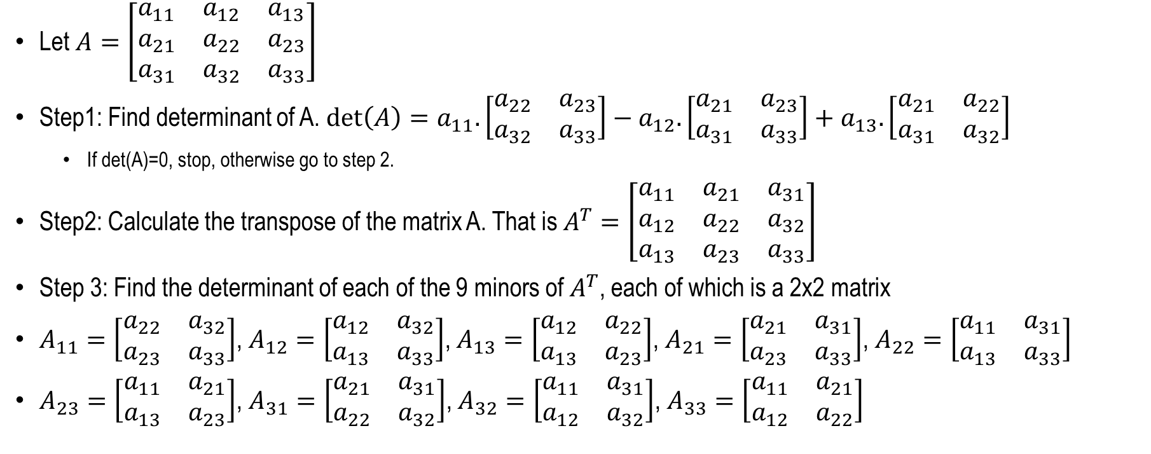
Matrix Inversion
For larger matrices
Let $A=\left[\begin{matrix}a_{11} & a_{12} & a_{13} \\ a_{21} & a_{22} & a_{23} \\ a_{31} & a_{32} & a_{33}\end{matrix}\right]$
Step1: Find determinant of A. $\det\left(A\right)=a_{11}.\left[\begin{matrix}a_{22} & a_{23} \\ a_{32} & a_{33}\end{matrix}\right]−a_{12}.\left[\begin{matrix}a_{21} & a_{23} \\ a_{31} & a_{33}\end{matrix}\right]+a_{13}.\left[\begin{matrix}a_{21} & a_{22} \\ a_{31} & a_{32}\end{matrix}\right]$
  If det(A)=0, stop, otherwise go to step 2.
Step2: Calculate the transpose of the matrix A. That is $A^{T}=\left[\begin{matrix}a_{11} & a_{21} & a_{31} \\ a_{12} & a_{22} & a_{32} \\ a_{13} & a_{23} & a_{33}\end{matrix}\right]$
Step 3: Find the determinant of each of the 9 minors of $A^{T}$, each of which is a 2x2 matrix
$A_{11}=\left[\begin{matrix}a_{22} & a_{32} \\ a_{23} & a_{33}\end{matrix}\right]$, $A_{12}=\left[\begin{matrix}a_{12} & a_{32} \\ a_{13} & a_{33}\end{matrix}\right]$, $A_{13}=\left[\begin{matrix}a_{12} & a_{22} \\ a_{13} & a_{23}\end{matrix}\right]$, $A_{21}=\left[\begin{matrix}a_{21} & a_{31} \\ a_{23} & a_{33}\end{matrix}\right]$, $A_{22}=\left[\begin{matrix}a_{11} & a_{31} \\ a_{13} & a_{33}\end{matrix}\right]$
$A_{23}=\left[\begin{matrix}a_{11} & a_{21} \\ a_{13} & a_{23}\end{matrix}\right]$, $A_{31}=\left[\begin{matrix}a_{21} & a_{31} \\ a_{22} & a_{32}\end{matrix}\right]$, $A_{32}=\left[\begin{matrix}a_{11} & a_{31} \\ a_{12} & a_{32}\end{matrix}\right]$, $A_{33}=\left[\begin{matrix}a_{11} & a_{21} \\ a_{12} & a_{22}\end{matrix}\right]$

Slide 16
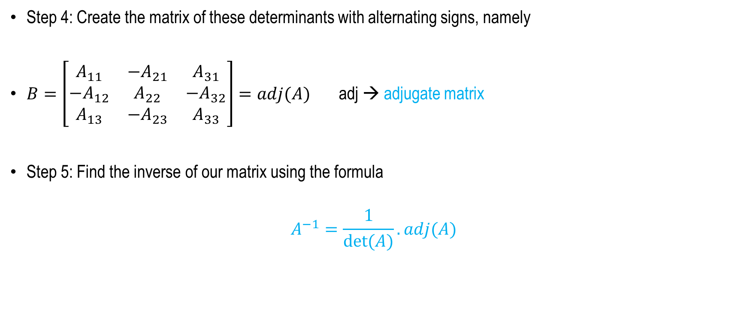
Matrix Inversion
For larger matrices
Step 4: Create the matrix of these determinants with alternating signs, namely
$B=\left[\begin{matrix}A_{11} & {−A}_{21} & A_{31} \\ {−A}_{12} & A_{22} & {−A}_{32} \\ A_{13} & {−A}_{23} & A_{33}\end{matrix}\right]=adj(A)$ adj → adjugate matrix
Step 5: Find the inverse of our matrix using the formula
$$A^{−1}=\frac{1}{det⁡(A)}.adj(A)$$

Slide 17
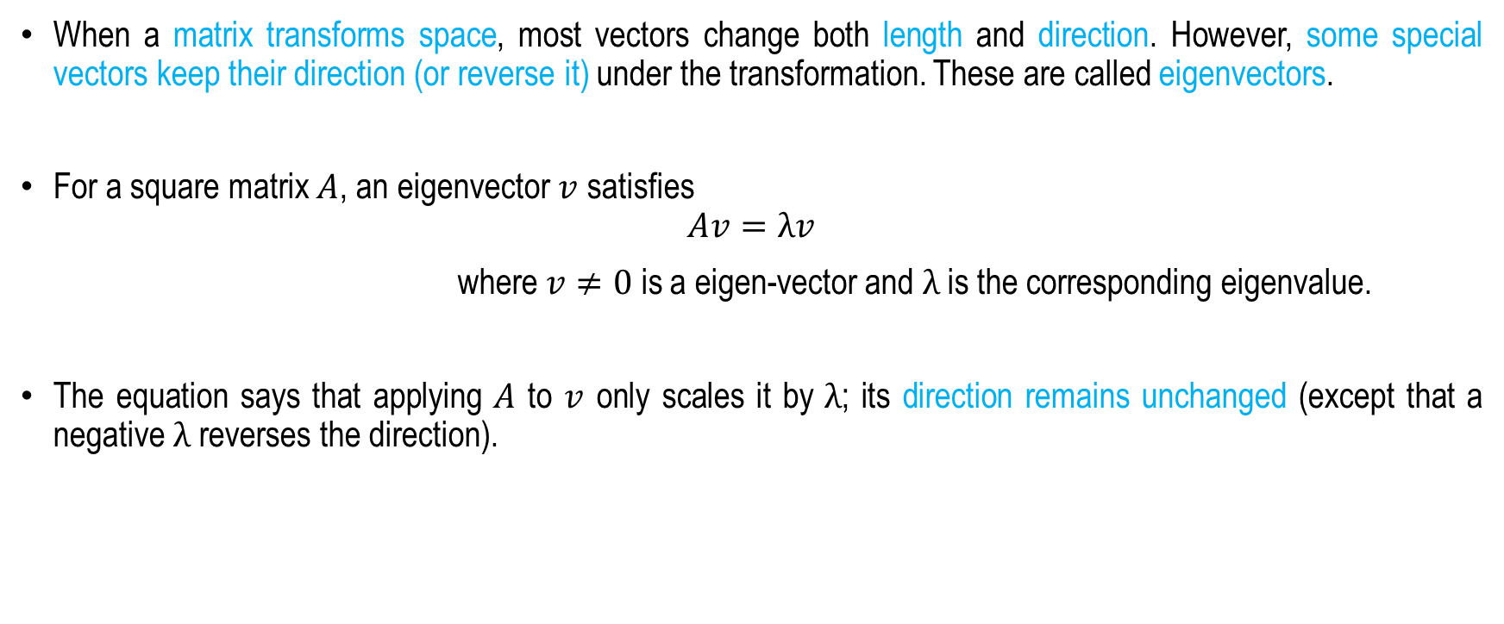
Eigenvalues and Eigenvectors
When a matrix transforms space, most vectors change both length and direction. However, some special vectors keep their direction (or reverse it) under the transformation. These are called eigenvectors.
For a square matrix $A$, an eigenvector $v$ satisfies
$$Av=λv$$
where $v≠0$ is a eigen-vector and $λ$ is the corresponding eigenvalue.
The equation says that applying $A$ to $v$ only scales it by $λ$; its direction remains unchanged (except that a negative $λ$ reverses the direction).

Slide 18
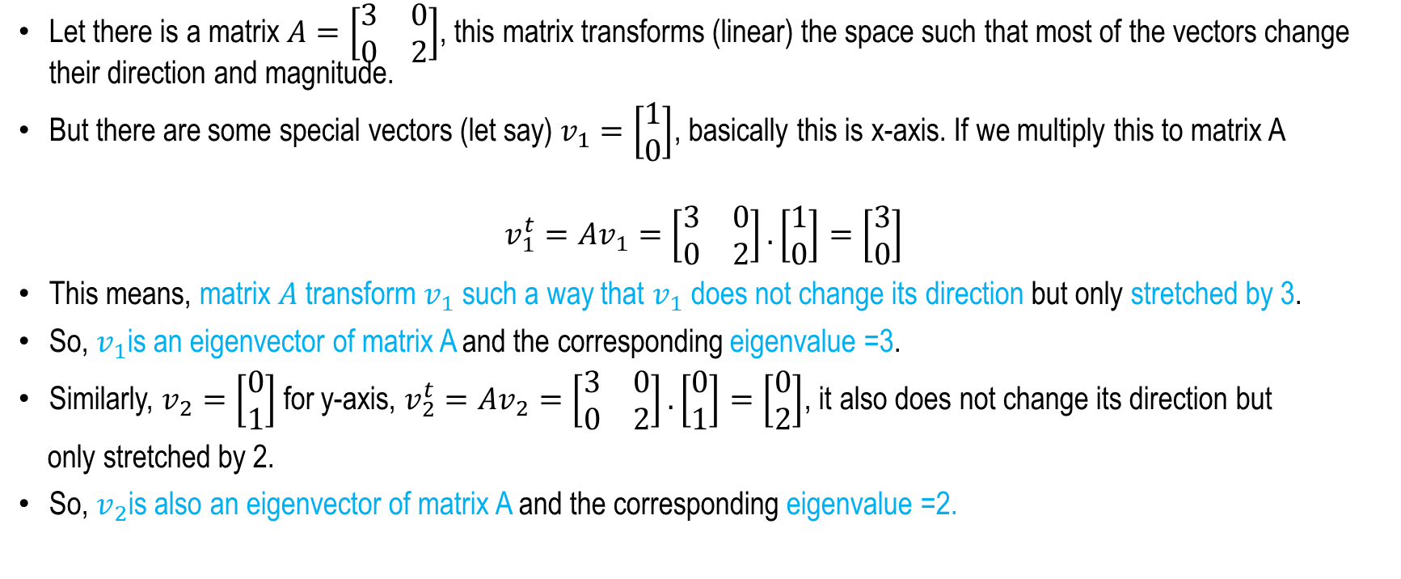
Eigenvalues and Eigenvectors
Geometric Interpretation
Let there is a matrix $A=\left[\begin{matrix}3 & 0 \\ 0 & 2\end{matrix}\right]$, this matrix transforms (linear) the space such that most of the vectors change their direction and magnitude.
But there are some special vectors (let say) $v_{1}=\left[\begin{matrix}1 \\ 0\end{matrix}\right]$, basically this is x-axis. If we multiply this to matrix A
$$v_{1}^{t}=Av_{1}=\left[\begin{matrix}3 & 0 \\ 0 & 2\end{matrix}\right].\left[\begin{matrix}1 \\ 0\end{matrix}\right]=\left[\begin{matrix}3 \\ 0\end{matrix}\right]$$
This means, matrix $A$ transform $v_{1}$ such a way that $v_{1}$ does not change its direction but only stretched by 3.
So, $v_{1}$is an eigenvector of matrix A and the corresponding eigenvalue =3.
Similarly, $v_{2}=\left[\begin{matrix}0 \\ 1\end{matrix}\right]$ for y-axis, $v_{2}^{t}=Av_{2}=\left[\begin{matrix}3 & 0 \\ 0 & 2\end{matrix}\right].\left[\begin{matrix}0 \\ 1\end{matrix}\right]=\left[\begin{matrix}0 \\ 2\end{matrix}\right]$, it also does not change its direction but
only stretched by 2.
So, $v_{2}$is also an eigenvector of matrix A and the corresponding eigenvalue =2.

Slide 19



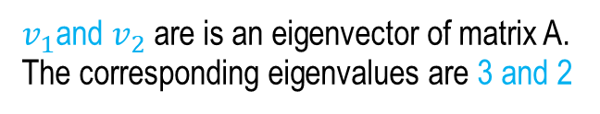


Geometric Interpretation
$v_{1}=\left[\begin{matrix}1 \\ 0\end{matrix}\right]$, $v_{2}=\left[\begin{matrix}0 \\ 1\end{matrix}\right],v_{3}=\left[\begin{matrix}1 \\ 1\end{matrix}\right]$
0,1
1,1
$v_{1}$and $v_{2}$are is an eigenvector of matrix A.
The corresponding eigenvalues are 3 and 2
1,0
But $v_{3}$is NOT an eigenvector of matrix A
$$A=\left[\begin{matrix}3 & 0 \\ 0 & 2\end{matrix}\right]$$
0,2
3,2
1,1
0,1
1,0
3,0
$v_{1}^{t}=\left[\begin{matrix}3 \\ 0\end{matrix}\right]$,$v_{2}^{t}=\left[\begin{matrix}0 \\ 2\end{matrix}\right],v_{3}^{t}=\left[\begin{matrix}3 \\ 2\end{matrix}\right]$

Slide 20
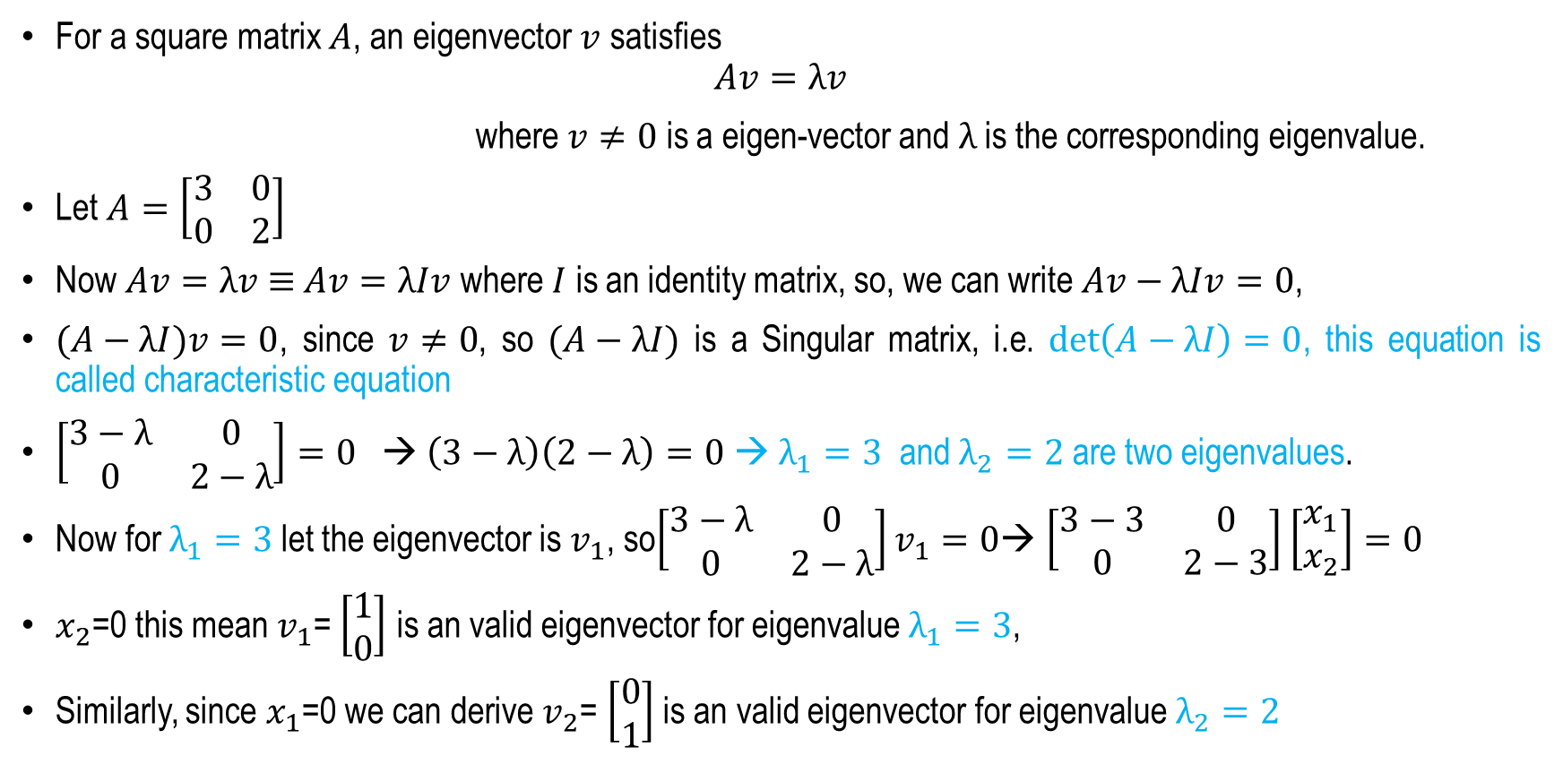
How to find Eigenvalues and Eigenvectors of a matrix?
For a square matrix $A$, an eigenvector $v$ satisfies
$$Av=λv$$
where $v≠0$ is a eigen-vector and $λ$ is the corresponding eigenvalue.
Let $A=\left[\begin{matrix}3 & 0 \\ 0 & 2\end{matrix}\right]$
Now $Av=λv$ $≡$ $Av=λIv$ where $I$ is an identity matrix, so, we can write $Av−λIv=0$,
$(A−λI)v=0$, since $v≠0$, so $(A−λI)$ is a Singular matrix, i.e. $det\left(A−λI\right)=0$, this equation is called characteristic equation
$\left[\begin{matrix}3−λ & 0 \\ 0 & 2−λ\end{matrix}\right]=0$ → $\left(3−λ\right)\left(2−λ\right)=0$ → $λ_{1}=3$ and $λ_{2}=2$ are two eigenvalues.
Now for $λ_{1}=3$let the eigenvector is $v_{1}$, so$\left[\begin{matrix}3−λ & 0 \\ 0 & 2−λ\end{matrix}\right]v_{1}=0$→ $\left[\begin{matrix}3−3 & 0 \\ 0 & 2−3\end{matrix}\right]\left[\begin{matrix}x_{1} \\ x_{2}\end{matrix}\right]=0$
$x_{2}$=0 this mean $v_{1}$= $\left[\begin{matrix}1 \\ 0\end{matrix}\right]$ is an valid eigenvector for eigenvalue $λ_{1}=3$,
Similarly, since $x_{1}$=0 we can derive $v_{2}$= $\left[\begin{matrix}0 \\ 1\end{matrix}\right]$ is an valid eigenvector for eigenvalue $λ_{2}=2$

Slide 21
Summary
  Vectors
    Definitions
    Basic Operations on Vectors
  Matrices
    Representations and Basic Operations
    Matrix Transpose and Inverse
  Eigenvalues and Eigenvectors
    Definition
    Geometrical Interpretation

Slide 22
Mathematical Preliminaries – II
(Basic Probability)
Next
Lecture 2:Part 2
Generative AI for Computer Vision

Slide 23
Extra Slide
Geometric Interpretation of Singular Matrix
A singular matrix collapses space into a lower dimension. For example, a transformation represented by a singular matrix may compress a two-dimensional plane into a single line. Because information is lost during this transformation, the original data cannot be uniquely recovered, which is why the matrix has no inverse.
Importance in Machine Learning
Singular matrices often appear when:
Features are highly correlated (multicollinearity).
Duplicate features exist in a dataset.
The number of features exceeds the number of samples.
Computing matrix inverses in linear regression.
When a matrix is singular, algorithms typically use techniques such as regularization, matrix factorization, or the Moore–Penrose pseudoinverse instead of a standard matrix inverse.
Understanding singular matrices is important because they help explain why some machine learning problems do not have unique solutions and why alternative numerical methods are often required.

